Slide 1
LIFE AFTER UNIVERSITY
A Presentation to the Community and University Students
At Kisubi University on
15th March 2023
By
DR. C.T. MUKASA – LUSAMBU
Retired Commissioner for Basic Education (MoES)
Director: Mivule Primary Schools
EDUCORS Education Consultancy
Kattikkiro wa Mazige – Mpindi Clan
0782-830114
lusambuless@gmail.com

Slide 2
Time to prepare for life after university is now:
Have a vision, Mission and Goal for your life
The Ubuntu (Humane)
Abantu (Human Capital – People)
Ebintu (Property – wealth – success)

Slide 3
What is Education?
What job are you to do after University?
Ethics – Integrity
Character
Values, morals, norms, culture

Slide 4
Financial Literacy:
Earn, save, learn to invest, invest.
Saving as a culture
Daily income
Monthly income
Long term income/ Investment

Slide 5
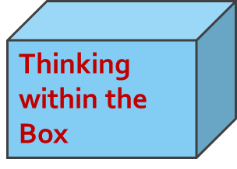


The Analogy of the Box:
19TH Century 20th Century
Thinking outside the Box
21st Century
Thinking without the Box

Slide 6
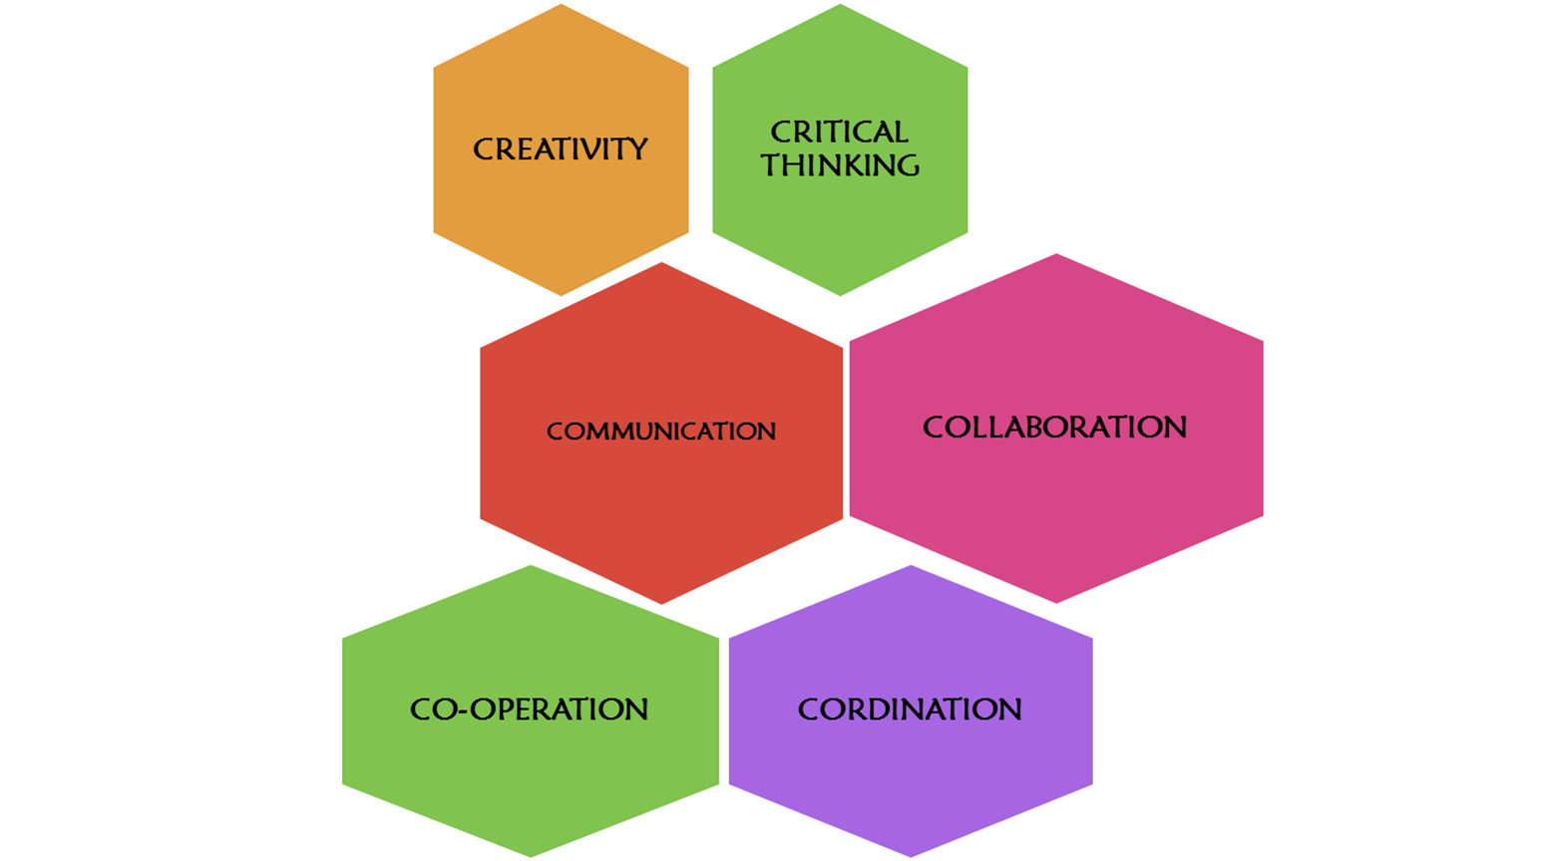
The Six Critical (C’s) skills of the 21st
Century:
“This 21st Century will only be enjoyed by people with
Capacity to learn, re-learn and unlearn.”

Slide 7
Real Life
Relationship with God and successful people
Always be relevant, objective and useful (Ogasa?)
Have big ideas but start small
If you don’t start, you will never start

Slide 8
Maintain Good Health
Healthy feeding
Healthy lifestyle
Self control
Start preparing for retirement the day you start working

Slide 9
Work towards a Legacy
Be responsible for:
Yourself
Your actions
Those under you
Avoid pointing fingers

Slide 10
Be Positive to the world:
Participate in Civil Societies:
Religious Organisations
Bulungibwansi
Rotary Clubs, etc…
“Remember the Past with gratitude, live
the present positively and focus into the
future with hope and enthusiasm.”

Slide 11
Learn to Learn:
The UNO outlines 4 major reasons for learning:
Learning to DO
Learning to KNOW
Learning to BE and
Learning to LIVE TOGETHER WITH OTHERS
“Our children, our future, and our future,
our children.”

